Slide 1
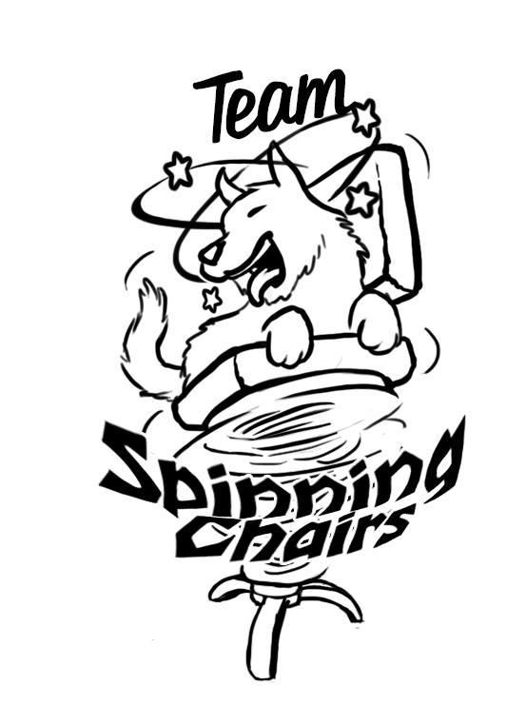
Vessoul
by

Slide 2
Who are the chair-people?
Core Development Team:
Esteban Maldonado - Producer, Graphics Programmer
Judy Cheng - Physics Programmer
Steven Gallwas - Co. Game Designer & Gameplay Programmer
Henry Morgan - Engine Developer
Ian Aemmer - Lead Game Designer
Content Development Team:
Bernie Hansen - Lead Artist
Claude Alaras - Lead Sound Designer
These guys are awesome!

Slide 3
Main Game Concept 1
-High concept (insert screenshot)
-2D platformer/runner.
-Player runs from a wall of Death as it slowly eats away at the world.
-Gameplay
-Player runs towards the right and attempts to platform quickly without the loss of motion. -Enemy eats away at the world to create dynamic changes in platform stability/availability

Slide 4
Game Concept 2
-High concept (insert screenshot)
-2D Drop-in Drop-out Multiplayer couch Game.
-Gameplay
-Teams of players pass “core” back and forth between each other
-Players with the core can activate platforms and create dynamic shifts in the level, but are slower
-”Keep away” the core from the opposing team

Slide 5
Game Concept 3
-High concept (insert screenshot)
-2D Asymmetric versus platformer/runner.
-Cat and Mouse “Catch the Runner” or “Tag You’re it” gameplay.
-Gameplay
-One player tries to catch all the other players.
-Caught players become catchers.
-When last runner is caught, players switch places.

Slide 6
Main concept / Current goal.
-Our Three prototypes
-Concept 1
-Player runs from a wall of Death as it slowly eats away at the world.
-Concept 2
-2D Drop-in Drop-out Multiplayer couch Game.
-Concept 3
-2D Asymmetric versus platformer/runner.
(insert Hyperlink to prototype)

Slide 7
Prototyping and Playtesting Information:
-Player speed and mobility
-Gravity and Jump height
-Size of sprites on Screen (Visibility of objects)
-Player behavior towards Enemies

Slide 8
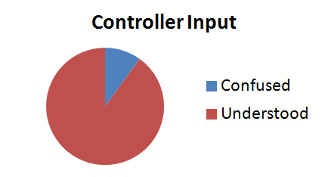
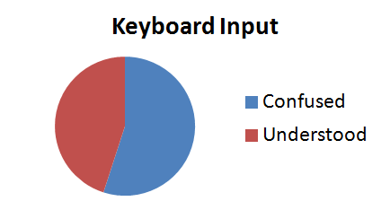
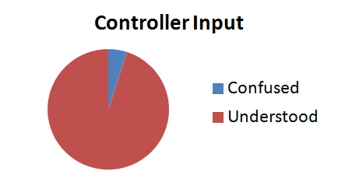
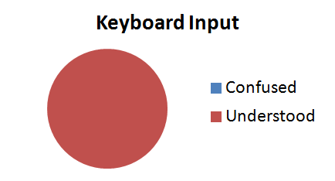
Pre-Change Control Understanding
Pre-Change Control Understanding

Slide 9
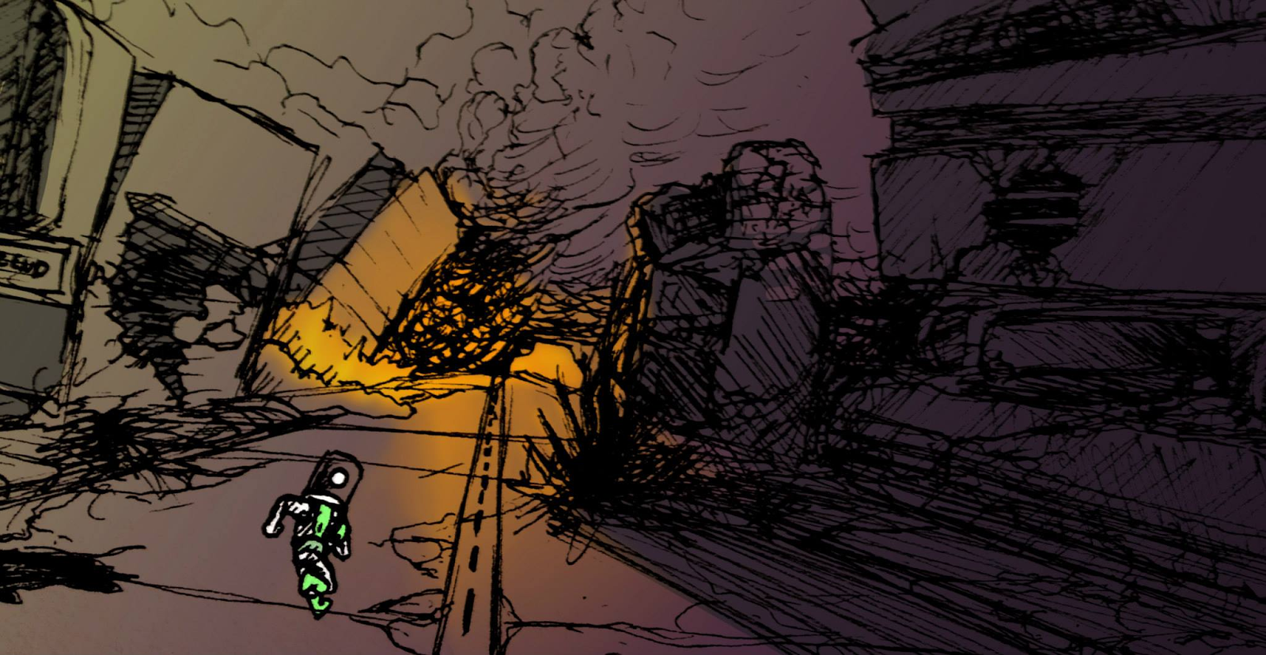
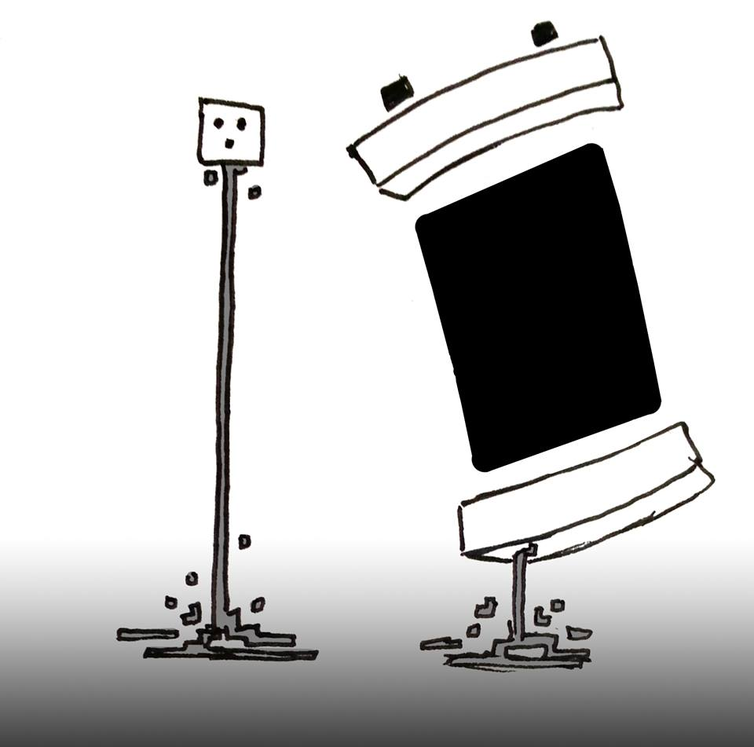
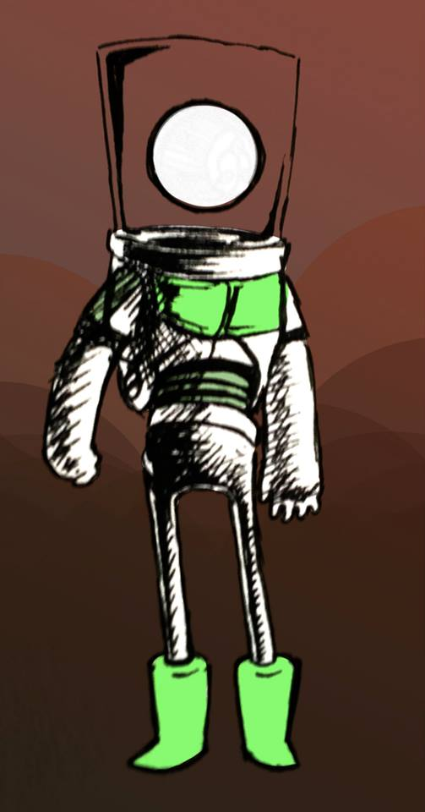
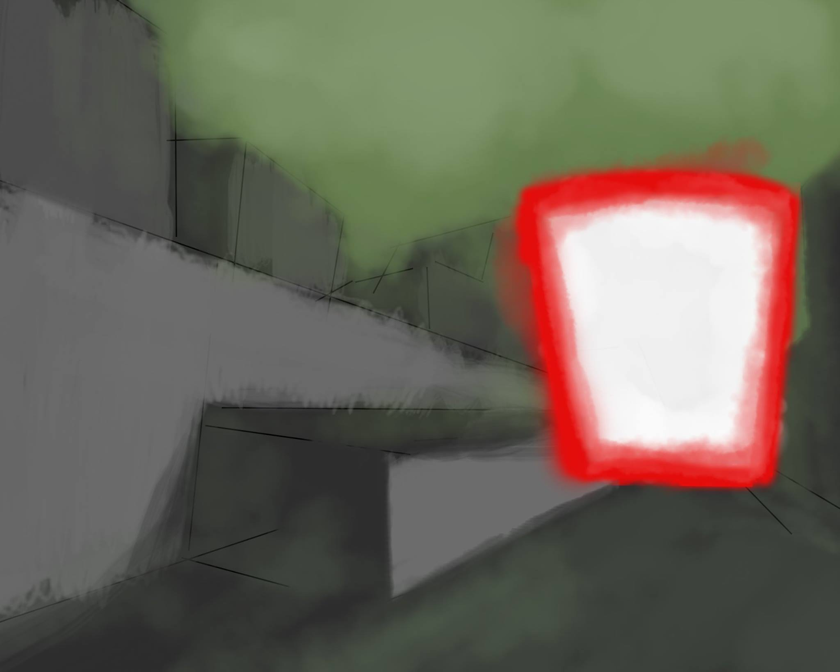
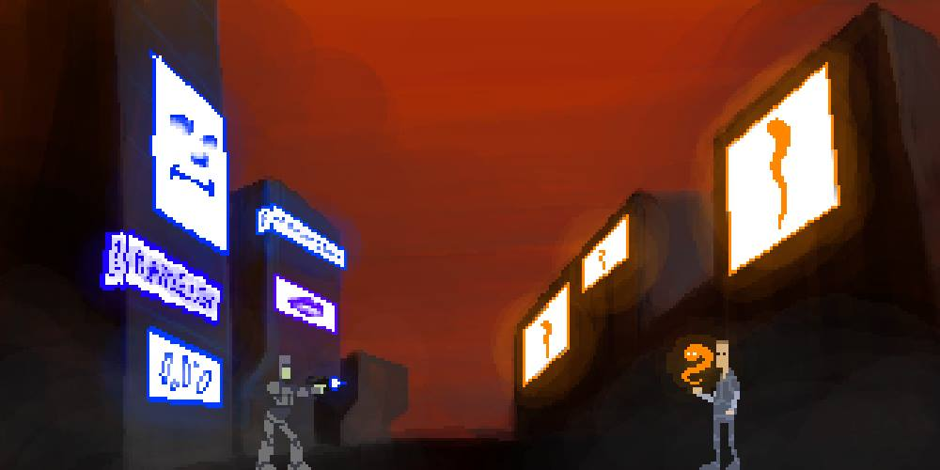
Some concept art

Slide 10
The Spin Engine...
Component Based Architecture
Tools:
Visual Studio with Visual Assist
Premake4
Photoshop
DigiPen SVN for current builds.
Git with Source Tree for development.

Slide 11
Basic Engine Structure
Application / Game
Each System:
bool Initialize() = 0;
void Update(float dt) = 0;
void ShutDown() = 0;
string name;
SystemType type;
Core
Engine Systems
Physics
Object Factory
Game Logic
Graphics
Input
Others
Utilities

Slide 12

The IEntity* or Game Object
Functions:
bool Initialize();
void Update();
void ShutDown();
EachComponent:
virtual bool Initialize() = 0;
virtual void Update(float dt) = 0;
string component_name;
Component_Type type;
GameObject Owner;
Member variables:
bool IsVisible;
void IsActive;
string tag;
string name;
unordered_map Components

Slide 13
Graphics
DirectX 9 Graphics API.
Animations with the Sprite Interface.
Sprites can be translated, rotated and scaled at runtime.

Slide 14
Physics
AABB and Circle
Collision Detection
AABB-AABB
Circle-Circle
AABB-Circle
Simple Resolution
Impulse system
Object destroyed

Slide 15
Game Object Factory
Data-driven level creation.
Tiled level editor.
Exports to JSON.
Tilemaps and custom objects.
Load tiles and custom objects as prefabs with optional custom settings set in editor.

Slide 16
Serializer
JSON Format.
One master file containing paths to sub-files.
Data-driven loading of game settings, object prefabs, sprite data, and all other assets.
Saving is implemented, not integrated.

Slide 17
(A picture of the Tiled project containing the current tiles drawn).

Slide 18
Messaging System
Base Listener Class
OnMessageReceived function
New listeners Inherit from for different functionality
Register / Unregister Listener Objects
Only receive messages of a specific type

Slide 19
Input Manager
Two Types of Input:
Keyboard
XInput for XBOX 360 controllers.
Input managers Dispatch messages to components.

Slide 20
Where we’re headed
Further physics testing.
Integrate FMOD to engine.
Adding more graphics components likeParticleSystems.
More playtesting.

Slide 21
Risks & Mitigations
Risk: We have very different schedules.
Mitigation: Meet 4 hours per week to work on game.
Risk: 1st time working as a team together.
Mitigation: Team on One with Rachel, great communication between us.

Slide 22
Risks & Mitigations(continued)
Risk: We’ve yet to find a full balance on gameplay.
Mitigation: Design towards incrementing the interaction space between player and wall.
Risk: Haven’t integrated FMOD to engine.
Mitigation: Just do it and ask for help to upper classmen or Chris Peters.

Slide 23
Thanks!

